Slide 1

Save the Striders!
Danielle Tadych, Jacob Ridlinghafer, Benjamin Mitchell

Slide 2
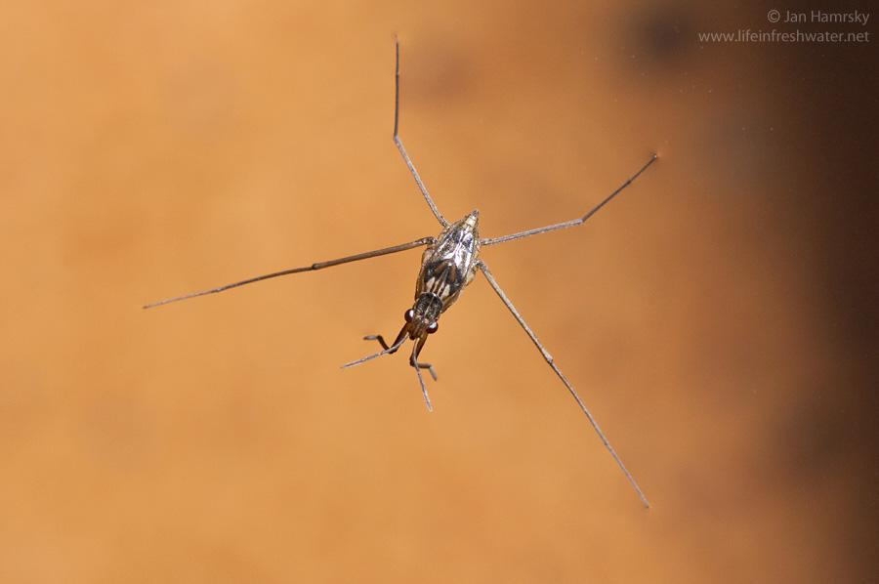
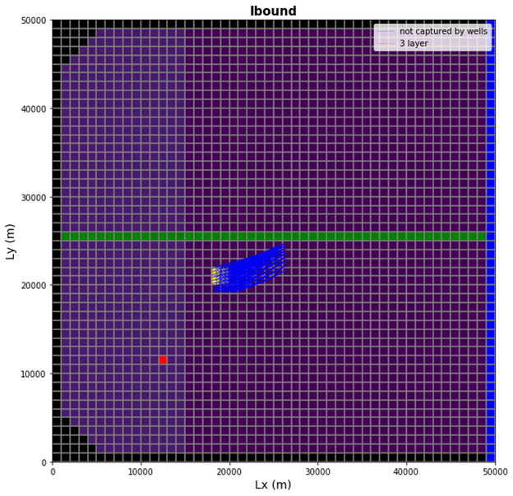

Problems with Current Setup
Too close to the stream and riparian area
Pollution of the stream
Too much drawdown from the ag well
Gotta protect the water strider!
Don’t want to impair the riparian ecosystem
What matters
Head at wells and leakage
Head at MW1 is most important
Other wells matter because stage in river is not actually infinite
Particle pathing because we don’t want to pollute river

Slide 3
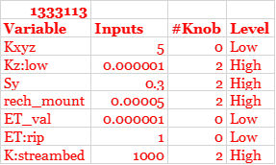
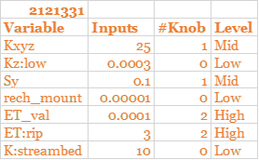
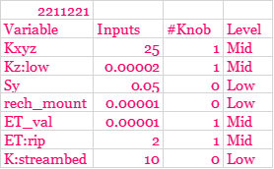
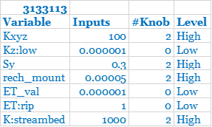
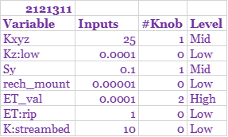
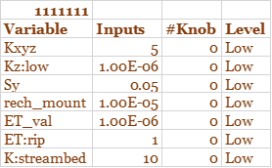
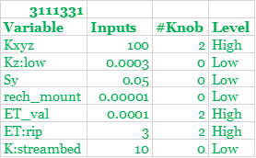
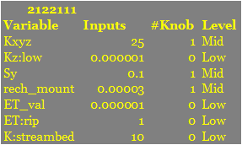

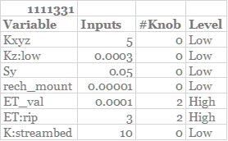
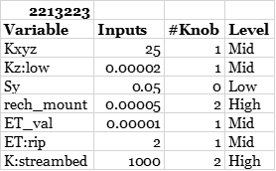
Ensemble Scenarios
Metrics considered
Head at MW next to the river
Head from ensembles for each scenario
Particle tracking
Leakage calculation
1333113
3133113
3111331
1111331
2121331
2121311
2122111
2213223
2211221
1111111

Slide 4
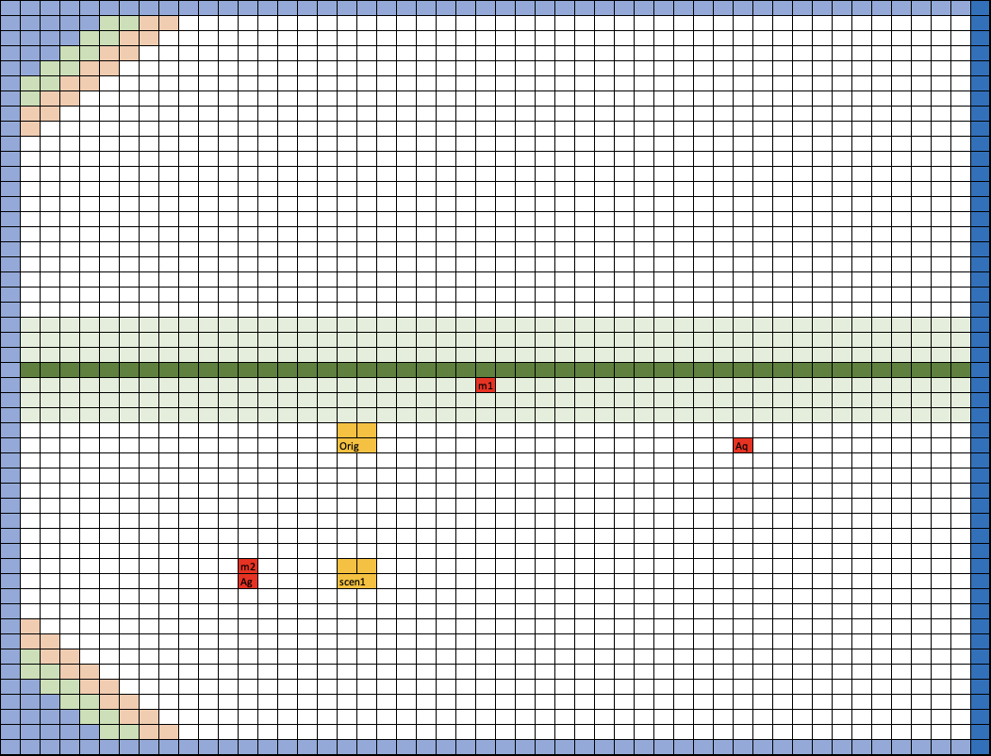
Proposed Scenarios - Scenario 1
Moving the Farm farther south
Closer to the ag well, so even though relocation might be difficult, it would save in water transportation costs

Slide 5
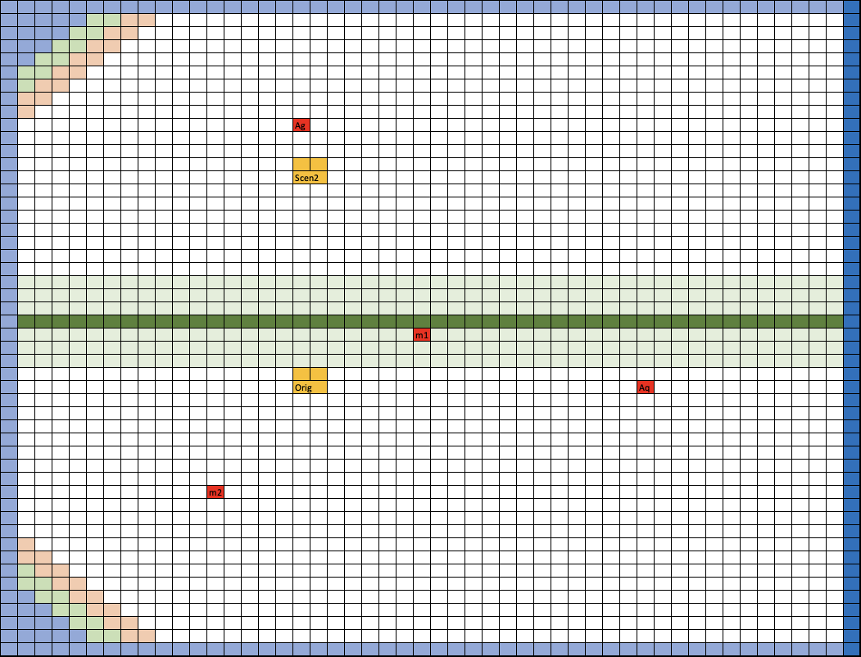
Proposed Scenarios - Scenario 2
Moving the Farm farther south
Closer to the ag well, so even though relocation might be difficult, it would save in water transportation costs
Moving the farm and ag well north of the stream
Less risk of polluting the town well in the future
Ag well is farther from the stream but also closer to the farm

Slide 6

Proposed Scenarios
Moving the Farm farther south
Closer to the ag well, so even though relocation might be difficult, it would save in water transportation costs
Moving the farm and ag well north of the stream
Less risk of polluting the town well in the future
Ag well is farther from the stream but also closer to the farm
Scenario 1 locations but change crop to wheat (less water demand)
ET 3000 -> 4500

Slide 7
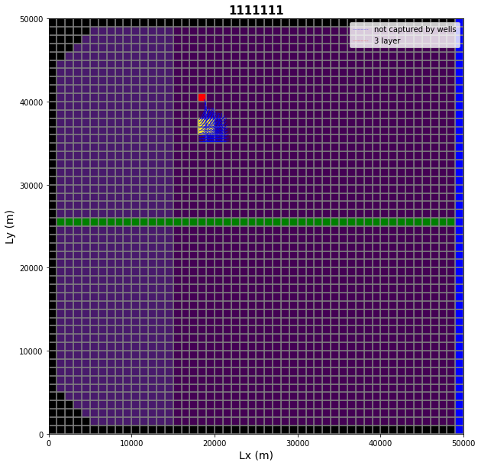
Scenarios we trashed and other problems
Had to move the ag well location for Scenario 2 to one cell to the left
Ensembles with high top and bottom aquifer K would not converge
3133113 and 3111331

Slide 8

Results

Slide 9
Ensemble comparison
 | Scenario 1
 | Esemble | town well | mw1 | mw2 | ag well | Leakage
1 | 1333113 | 74.34 | 78.98 | 89.333 | 86.81471 | 150750
2 | 3133113
3 | 3111331 | 75.43 | 78.65 | 85.06 | 84.74 | 2504950
4 | 1111331 | 71.88 | 76.28 | 81.30 | 78.30 | 296350
5 | 2121331 | 74.57 | 77.99 | 84.75 | 84.03 | 1119850
6 | 2121311 | 75.06 | 78.35 | 85.02 | 84.30 | 1072550
7 | 2122111 | 76.08 | 78.50 | 82.78 | 79.81 | 225650
8 | 2213223 | 75.98 | 78.55 | 87.33 | 86.70 | 1131750
9 | 2211221 | 75.77 | 78.56 | 85.11 | 84.38 | 1054350
10 | 1111111 | 75.77 | 78.56 | 85.11 | 84.38 | 225650
 | Average | 74.99 | 78.27 | 85.09 | 83.72 | 864650

Slide 10
Ensemble comparison
 | Scenario 2
 | Ensemble | town well | mw1 | mw2 | ag well | Leakage
1 | 1333113 | 74.34 | 79.01 | 93.13 | 82.33 | 148550
2 | 3133113
3 | 3111331
4 | 1111331 | 71.93 | 76.36 | 87.21 | 75.89 | 293350
5 | 2121331 | 74.63 | 78.02 | 86.04 | 82.08 | 1116450
6 | 2121311 | 75.11 | 78.38 | 86.30 | 82.32 | 1069050
7 | 2122111 | 76.11 | 78.71 | 87.58 | 83.37 | 981350
8 | 2213223 | 76.04 | 78.59 | 88.60 | 84.16 | 1127950
9 | 2211221 | 75.84 | 78.59 | 86.41 | 82.39 | 1050750
10 | 1111111 | 75.84 | 78.59 | 86.41 | 82.39 | 222150
 | Average | 74.98 | 78.28 | 87.71 | 81.87 | 751200

Slide 11
Ensemble comparison
 | Scenario 3
 | Esemble | town well | mw1 | mw2 | ag well | Leakage
1 | 1333113 | 74.34 | 78.99 | 90.61 | 88.98 | 149750
2 | 3133113
3 | 3111331
4 | 1111331 | 71.89 | 76.31 | 83.33 | 81.38 | 293250
5 | 2121331 | 74.59 | 78.00 | 85.19 | 84.66 | 1115750
6 | 2121311 | 75.08 | 78.37 | 85.46 | 84.92 | 1068350
7 | 2122111 | 76.12 | 78.55 | 84.80 | 82.86 | 222050
8 | 2213223 | 76.00 | 78.57 | 87.76 | 87.31 | 1127150
9 | 2211221 | 75.79 | 78.57 | 85.55 | 85.01 | 1049950
10 | 1111111 | 75.79 | 78.57 | 85.55 | 85.01 | 222050
 | Average | 74.95 | 78.24 | 86.03 | 85.01 | 656037.5

Slide 12
Head and Leakage Averages across Ensembles
Scenario # | town well | mw1 (River) | mw2 | ag well | Leakage
1 | 74.987 | 78.269 | 85.090 | 83.717 | 864650
2 | 74.978 | 78.282 | 87.707 | 81.868 | 751200
3 | 74.952 | 78.241 | 86.033 | 85.0177 | 656037.5

Slide 13
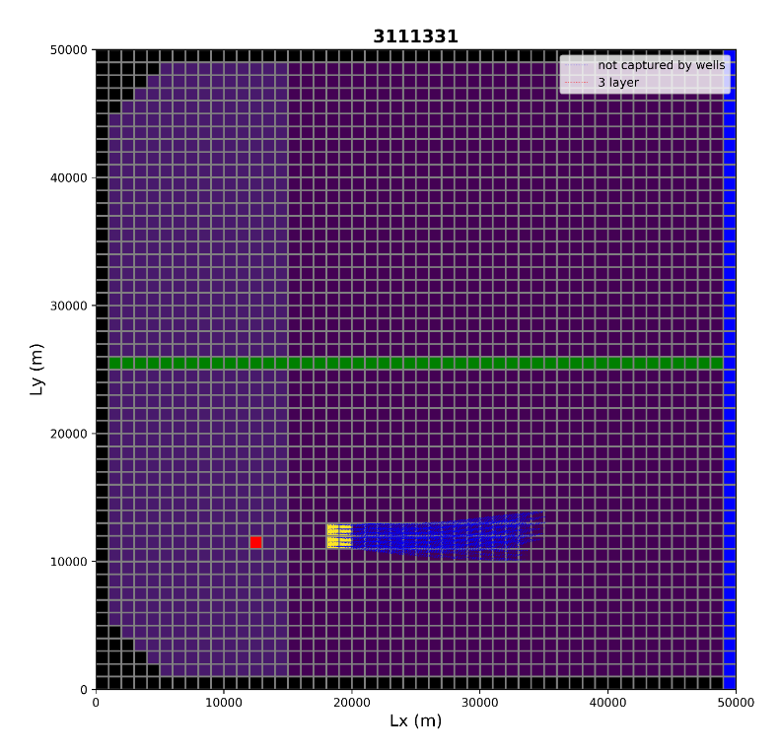
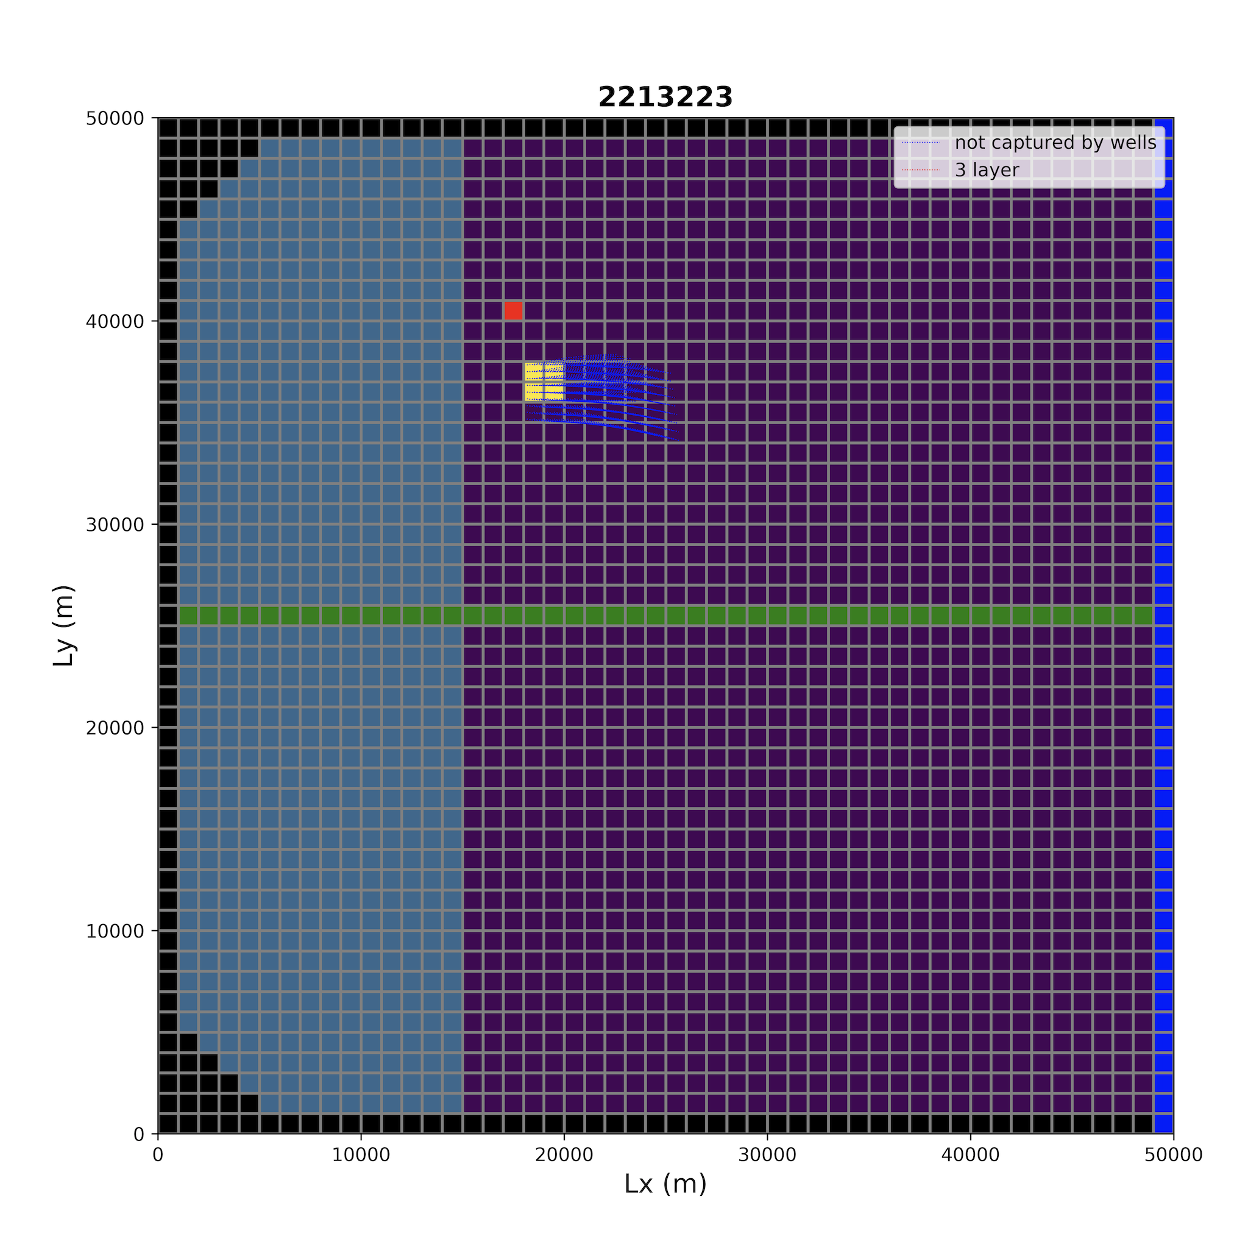
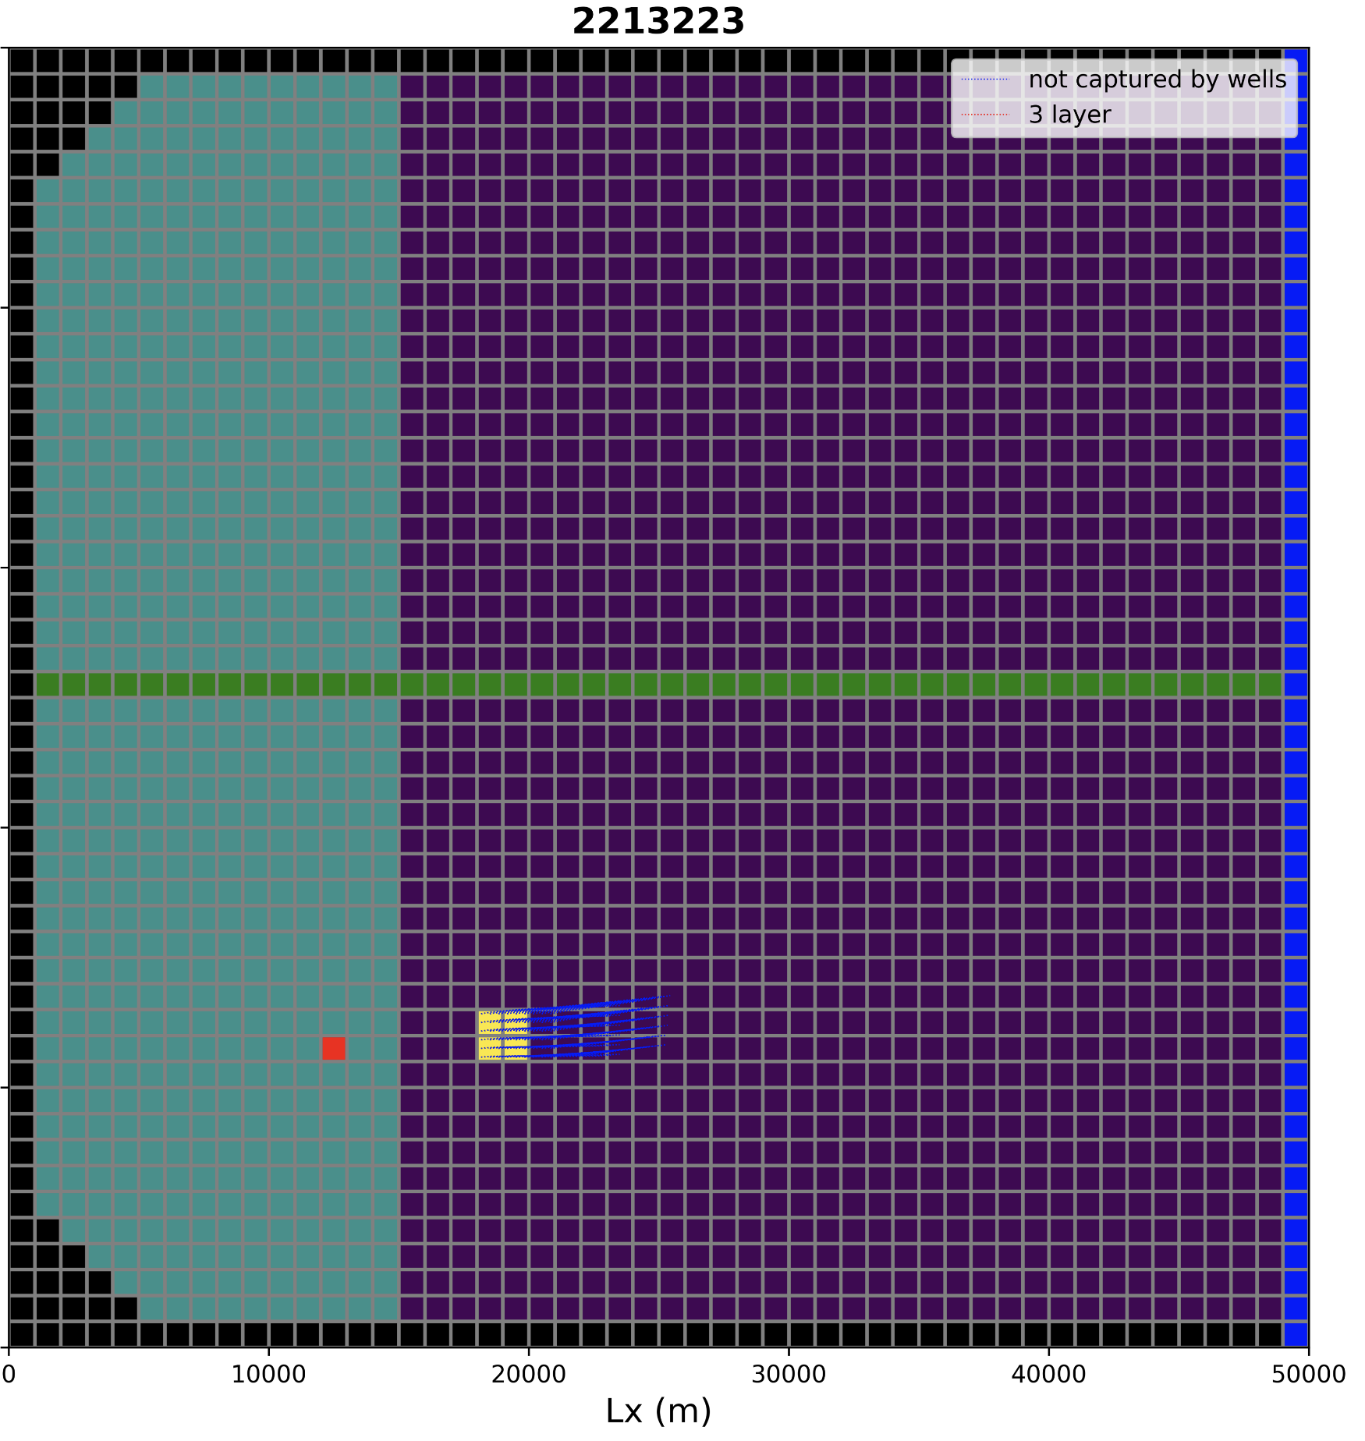
Path comparison - longest paths
Original run would have ended in the stream eventually
No particles resulted in the stream or wells for all scenarios
Scenario 1
Scenario 2
Scenario 3

Slide 14
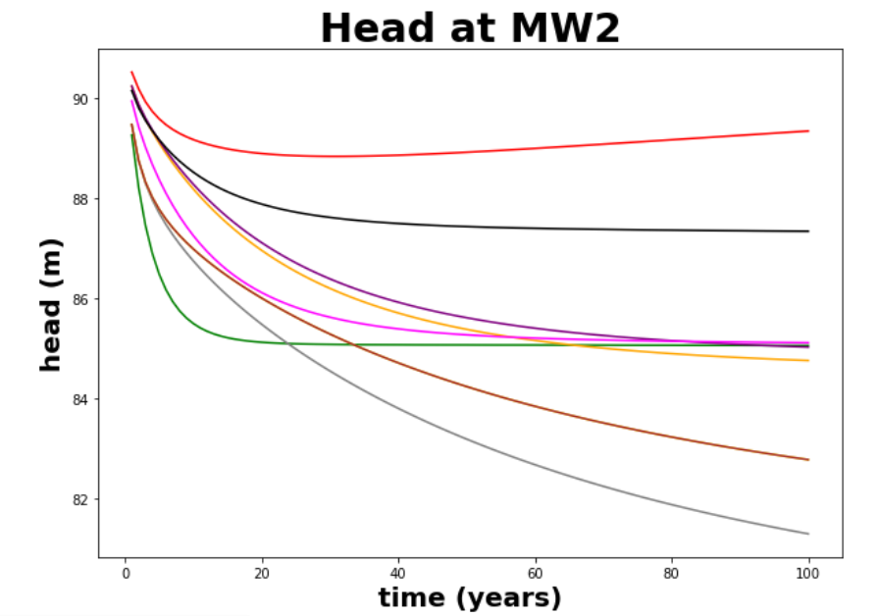
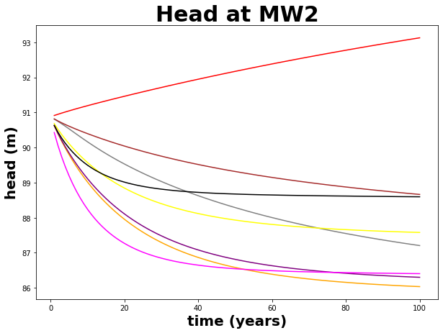
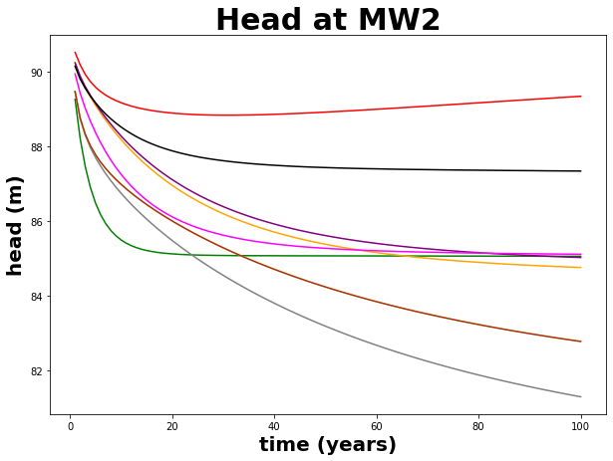
Head comparison (graphs) MW2
Legend
Ensemble | Line | Ensemble | Line
1333113 | red | 2121311 | purple
3133113 | blue | 2122111 | yellow
3111331 | green | 2213223 | black
1111331 | grey | 2211221 | pink
2121331 | orange | 1111111 | brown
Scenario 1
Scenario 2
Scenario 3

Slide 15
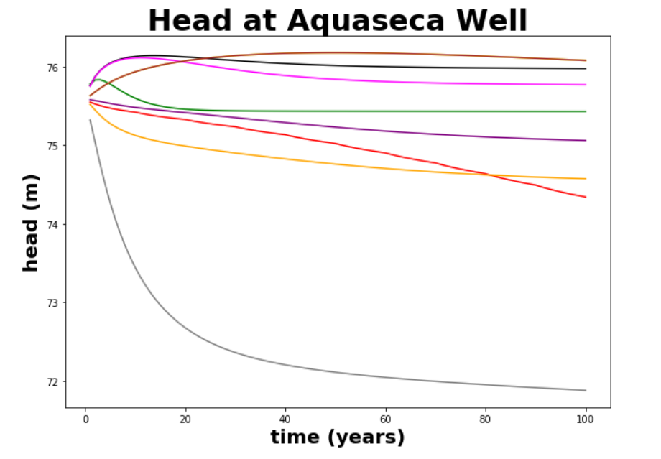
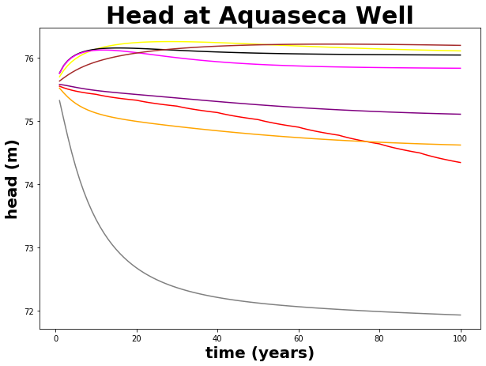
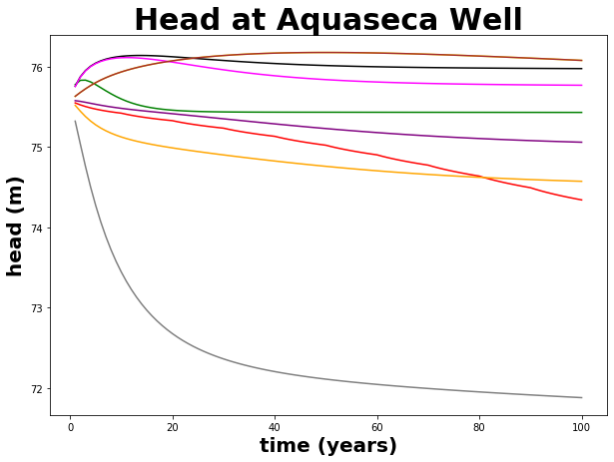
Head comparison (graphs) Town
Legend
Ensemble | Line | Ensemble | Line
1333113 | red | 2121311 | purple
3133113 | blue | 2122111 | yellow
3111331 | green | 2213223 | black
1111331 | grey | 2211221 | pink
2121331 | orange | 1111111 | brown
Scenario 1
Scenario 2
Scenario 3

Slide 16
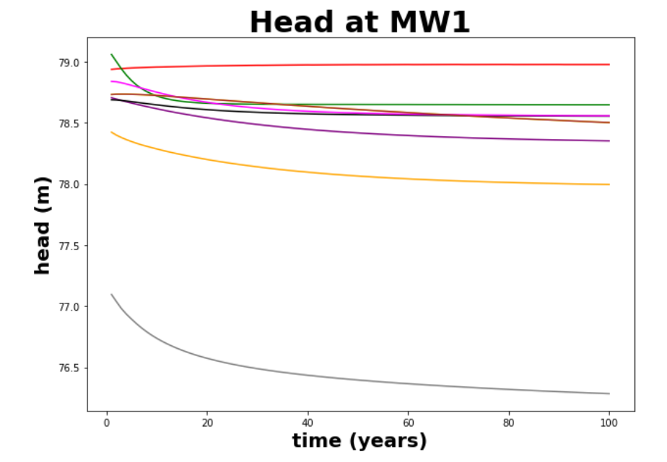
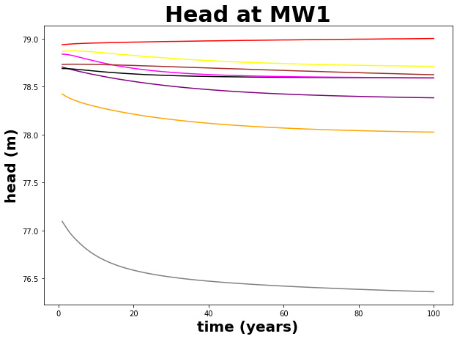
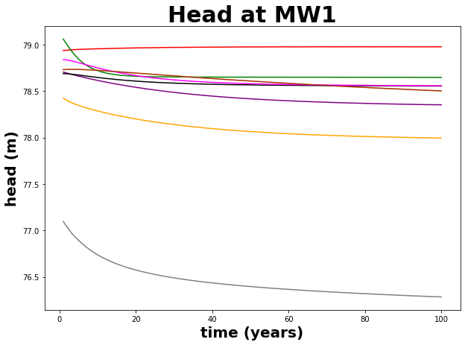
Head comparison (graphs) MW1
Legend
Ensemble | Line | Ensemble | Line
1333113 | red | 2121311 | purple
3133113 | blue | 2122111 | yellow
3111331 | green | 2213223 | black
1111331 | grey | 2211221 | pink
2121331 | orange | 1111111 | brown
Scenario 1
Scenario 2
Scenario 3

Slide 17
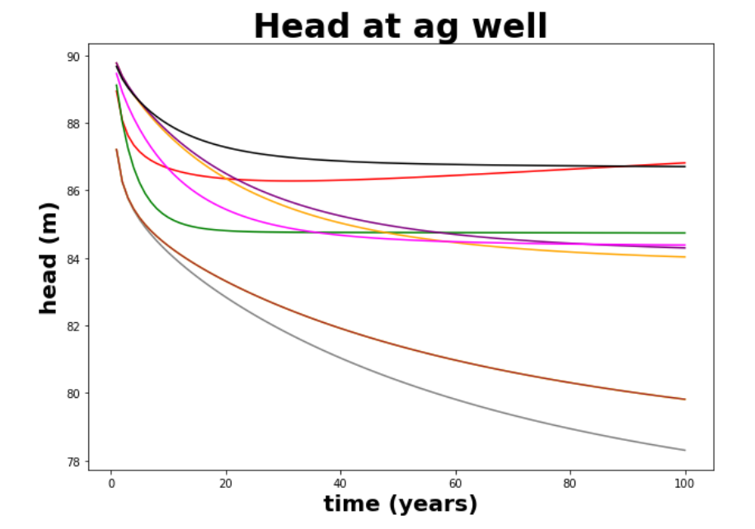
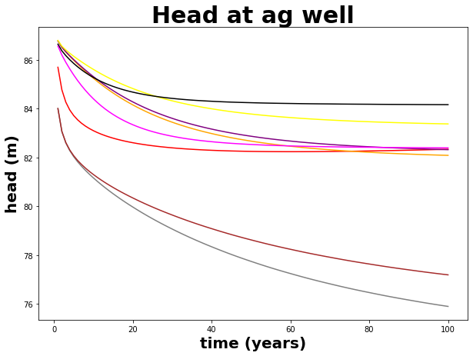
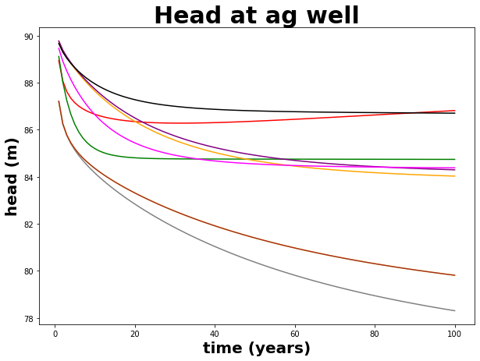
Head comparison (graphs) Ag well
Legend
Ensemble | Line | Ensemble | Line
1333113 | red | 2121311 | purple
3133113 | blue | 2122111 | yellow
3111331 | green | 2213223 | black
1111331 | grey | 2211221 | pink
2121331 | orange | 1111111 | brown
Scenario 1
Scenario 2
Scenario 3

Slide 18

Selected Hydrologic Design Conclusions
The differences in head at the river well were small
Differences at MW1 cannot be used in design 2 because ag well was moved
Head of the irrigation well showed larger differences design 3 had the least draw down
The total leakage of each location showed the largest differences in design where design 3 had the least leakage
So design 3 is our proposed project

Slide 19

Any Questions?
WWJBD

